Slide 1
Interest & Dividends
Pub 17, Chapters 7 & 8
Pub 4012, Tab D
(Federal 1040-Lines 8a-9b)
(NJ 1040-Lines 15a, 15b, 16)
Notes:
1

Slide 2
Interest Income
Interest Income
Income from banks & credit unions, CDs or bonds
Interest income is unearned income
When to report?
Report interest in year earned
In case of bond purchased at discount, increase in value is taxable in year of increase
Notes:
2

Slide 3
Interest Income
(cont’d)
End-of-year tax statements (for amounts > $10)
1099-INT
Bank Statement
1099-OID Original Issue Discount
1099-INT (Brokerage Statement)
Schedule K-1
Where to report?
Enter in Federal section \ Income \ Enter Myself \ Interest and Dividends (1099-INT, 1099-DIV) \ Interest or Dividend Income \ Interest Income, Form 1099-INT
If interest income > than $1,500, also must answer foreign account questions in Federal section \ Income \ Enter Myself \ Did you earn interest from a bank in a foreign country?
Flows through to Sch B & 1040 Lines 8a & 8b
Also flows to NJ 1040 15a & 15b
Notes:
Most banks/financial institutions do not generate a tax statement for under $10
3

Slide 4
Federal Tax-Exempt Interest
Generally bonds issued by:
State/political subdivisions (county or city), District of Columbia, or U.S. possessions & political subdivisions
Savings bonds used for education (Form 8815)
NJ does not always follow Federal taxability rules for interest
See NJ GIT-5 for list
Notes:
4

Slide 5
When is Interest Tax Free?
Interest Type | Exempt From Federal Tax | Exempt From NJ Tax
Interest from U.S. Savings Bonds |  | √
Interest from NJ state/municipal bonds | √ | √
Interest from state/municipal bonds other than NJ | √
Notes:
5

Slide 6
Sample 1099-INT
Taxable interest
2015
Early W/D penalty
Interest on US bonds
Federal tax withheld
Douglas Davis
201 Main Street
Tax-exempt interest
Notes:
This is a sample of the source document for Interest Income
Tax-exempt interest in Box 8 is for a NY bond
6

Slide 7
Sample Bank Statement
2015
Douglas Davis
210 Main Street
Bridgewater, NJ 08807
99-2222222
Taxable interest
2015
45.00
Notes:
This is another way Interest Income may be reported by a bank
7

Slide 8
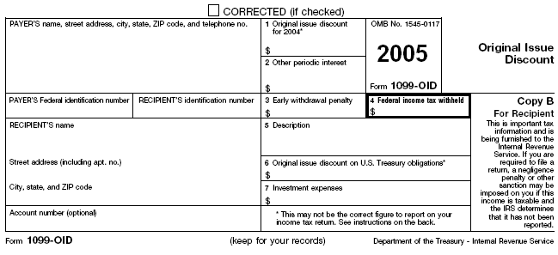
Sample Original Issue Discount Interest (OID)
2015
Enter as ordinary interest
Notes:
This is a sample of how Original Issue Discount is reported
Enter as Ordinary Interest
8

Slide 9
Sample 1099-INT (Brokerage)
2015 Interest Income

Slide 10
TS - Taxable Interest Federal section \ Income \ Enter Myself \ Interest & Dividends (1099-INT, 1099-DIV) \ Interest Income, Form 1099-INT
Taxable interest
Early withdrawal penalty
Interest on US govt. bonds
Federal tax withheld
Foreign tax withheld (for foreign tax credit)
Interest on US govt. bonds tax exempt for NJ
Notes:
Everything from the 1099-INT is entered on this TaxSlayer screen except the tax-exempt interest shown in Box 8
The taxable interest from this screen flows through to Schedule B & to 1040 Lines 8a Taxable Interest and then to NJ 1040 Lines 15a Taxable Interest
10

Slide 11
1099-INT Taxable Interest - TS Tips
Interest income in Box 1 is taxable for both Federal and NJ
Early withdrawal penalty in Box 2 is included in taxable interest for Federal, but can be offset by claiming an adjustment on Federal 1040 Line 30
TS automatically subtracts penalty from NJ taxable interest, so Federal and NJ taxable interest may differ
Total of taxable and non-taxable interest will be the same
Since interest on US govt. bonds is taxable for Federal, but not for NJ, must enter interest amount to be subtracted from NJ income
TS will automatically create appropriate Foreign Tax Credit on 1040 Line 48 if foreign tax withheld in Box 6
Notes:
11

Slide 12
1099-INT Federal Tax-Exempt Interest
Federal tax-exempt interest shown in Box 8 must be entered on a different screen than Federal taxable interest
Enter in Federal section \ Income \ Enter Myself \ Interest & Dividends (1099-INT, 1099-DIV) \ Interest or Dividend Income \ Tax Exempt Interest Income, Form 1099-INT, Box 8 or 1099-DIV, Box 10
If any of the Federal tax-exempt interest is taxable for NJ (e.g. – bond interest from other states), must add a Taxable State Interest Item screen to enter the amount
Notes:
12

Slide 13
TS - Federal Tax-Exempt Interest Federal section \ Income \ Enter Myself \ Interest & Dividends (1099-INT, 1099-DIV) \ Interest or Dividend Income \ Tax Exempt Interest Income, Form 1099-INT, Box 8 or 1099-DIV, Box 10
Federal tax-exempt interest
Click if Federal tax-exempt interest is taxable for NJ
Notes:
Use this TaxSlayer screen to enter tax-exempt interest that is shown in 1099-INT Box 8
Info from this Interest screen flows through to 1040 Line 8b Tax-Exempt Interest and then to NJ 1040 Line 15b Tax-Exempt Interest
13

Slide 14
TS - Federal Tax-Exempt Interest that is Taxable for NJ Federal section \ Income \ Enter Myself \ Interest & Dividends (1099-INT, 1099-DIV) \ Interest or Dividend Income \ Tax Exempt Interest Income, Form 1099-INT \ Taxable State Interest Item
Federal tax-exempt amount
that is taxable for NJ
Notes:
Use this screen to record any amount that is tax-exempt on the Federal, but taxable for NJ (such as bond interest from a state other than NJ)
14

Slide 15
Exclusion of Interest from Series EE & I US Savings Bonds Used for Educational Expenses
Savings bond education tax exclusion permits qualified taxpayers to exclude from gross income all or a portion of the interest earned on the redemption of eligible Series EE and I bonds issued after 1989
Must be at least 24 years old before bond’s issue date
Taxpayer, spouse, or dependent must incur qualified tuition and other educational expenses
Claim on Form 8815
Out of Scope
Notes:
15

Slide 16
1099-INT on Brokerage Statement
Summary of potentially many individual transactions
Only summary values need to be entered on TaxSlayer Interest screen (use name of Brokerage as payer)
Detail transactions usually listed later on statement
If there is a tax-exempt interest amount (Box 8), then that amount is tax exempt federally, but you may need to examine detail to determine how much is tax exempt for New Jersey
Tax-exempt mutual funds should have a breakdown of tax-exempt percentages by state

Slide 17
TS - Seller-Financed Mortgage Interest Federal Section \ Income \ Enter Myself \ Interest & Dividends (1099-INT, 1099-DIV) \ Seller Financed Interest Income
Buyer’s Name, SS #, Address, & Interest Income
Notes:
17

Slide 18
Dividends
Pub 4012 Tab D
Dividends
Part of the earnings of a corporation that is distributed to its shareholders
Unearned income
Ordinary and Qualified dividends segregated (different tax rates)
End-of-year tax statement:
1099-DIV Statement OR Brokerage Statement
Where to report?
Enter in Federal section \ Income \ Enter Myself \ Interest and Dividends (1099-INT, 1099-DIV) \ Interest or Dividend Income \ Dividend Income, Form 1099-DIV, Box 1
Flows through to Sch B & 1040 Lines 9a & 9b and NJ 1040 Line 16
Notes:
18

Slide 19
Sample 1099-DIV
Ordinary dividends
2015
Qualified dividends
Capital gains distribution
Diane Davis
Enter Foreign Tax Paid
201 Main Street
Foreign tax paid
Nondividend distributions - return of principal; not taxed until all cost recovered. Reduce cost by these distributions at time of sale
Notes:
This is a sample of how dividends are reported
Non Dividend Distribution may appear on 1099-Div. They should be entered in TS
Represents return of cost basis
Not taxed until total cost is recovered and investment is sold
At time of sale, reduce cost by amount of non dividend distribution to calculate gain/loss
19

Slide 20
Sample 1099-DIV (Brokerage)
2015 Dividends and Distributions

Slide 21
Dividends
Pub 4012 Tab D
Dividends
Part of the earnings of a corporation that is distributed to its shareholders
Unearned income
End-of-year tax statement:
1099-DIV Statement OR Brokerage Statement
Where to report?
Enter in Federal section \ Income \ Enter Myself \ Interest and Dividends (1099-INT, 1099-DIV) \ Interest or Dividend Income \ Dividend Income, Form 1099-DIV, Box 1
Flows through to Sch B & 1040 Lines 9a & 9b and NJ 1040 Line 16
Notes:
21

Slide 22
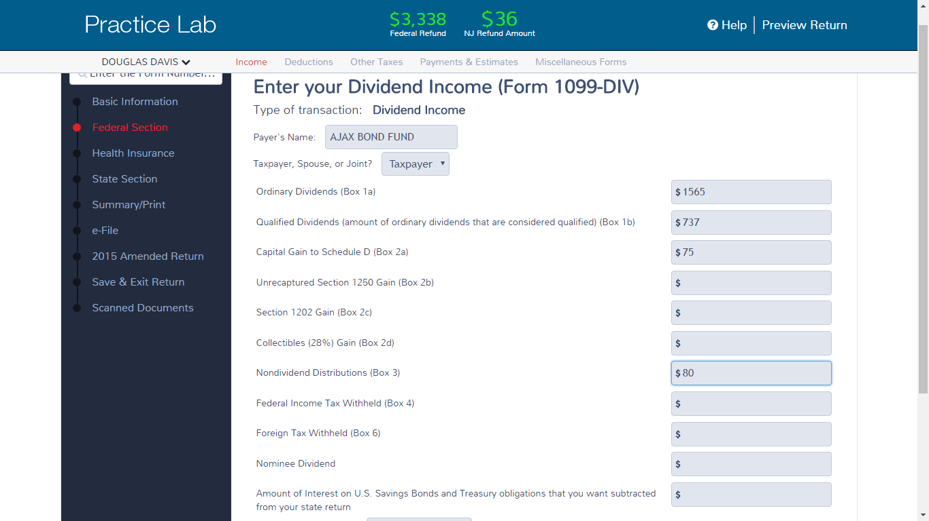
TS - 1099-DIV Dividends Federal section \ Income \ Enter Myself \ Interest & Dividends (1099-INT, 1099-DIV) \ Dividend Income, Form 1099-DIV, Box 1
Ordinary dividends
Qualified dividends
Capital gains distributions
Nondividend distributions
Foreign tax withheld
Notes:
22

Slide 23
1099-DIV Dividends - TS Tips
Ordinary and qualified dividends are separately identified by payer
Qualified dividends are a subset of ordinary dividends that meet specific criteria to be qualified and taxed at a lower tax rate
Capital gains distributions are payments shareholders get when a fund sells its holdings at a profit and must, by law, pass the profits along to shareholders
Not related to whether taxpayer sells shares at a profit
TaxSlayer will automatically create appropriate Foreign Tax Credit on 1040 Line 48 if foreign tax withheld in Box 6
Nondividend distributions are a return of cost basis and are not taxed until all cost is recovered. Still entered in TS
When you sell the investment, reduce your cost basis by the amount of nondividend distributions you have received
Notes:
23

Slide 24
1099-DIV on Brokerage Statement
Summary of potentially many individual transactions
Only summary values need to be entered in TaxSlayer (use name of Brokerage as payer)
Detail transactions backing up summary data are usually listed on later pages in statement

Slide 25
Exempt Interest Dividends from Mutual Funds
Tax exempt on Federal return
Taxability varies for NJ, depending on bonds held by fund (look at statement detail pages)
Interest attributable to Federal obligations (including P.R., territories, etc.) always tax exempt
Interest attributable to other states except NJ always taxable
Interest attributable to NJ bonds only tax exempt if fund is “NJ Qualified Investment Fund” (usually has NJ in name of fund)
Interest on NJ bonds held individually by taxpayer (not in a mutual fund) always tax exempt

Slide 26
TS – Entering Exempt Interest Dividends
Enter full amount of Federal Exempt Interest Dividends from Box 10 on Tax-Exempt Interest screen
Brokerage statement usually provides percentages of bonds in different categories (i.e. – Federal, each state). Apply those percentages to Federal Exempt Interest Dividends amount as appropriate
Add a Taxable State Interest Item screen
If Federal or multi-state fund, add all non-Federal amounts (including NJ amounts) as amount that is taxable for NJ
If fund is NJ specific, add only amount from states other than NJ as amount that is taxable for NJ

Slide 27
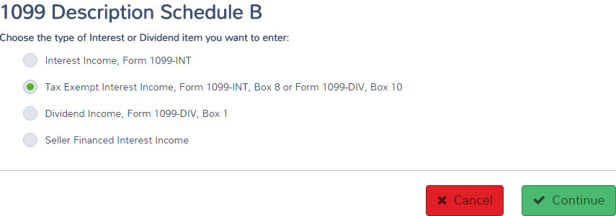
TS - 1099-DIV Exempt Interest Dividends Federal section \ Income \ Enter Myself \ Interest & Dividends (1099-INT, 1099-DIV) \ Tax Exempt Interest Income, Form 1099-INT, Box 8 or Form 1099-DIV, Box 10
Exempt Interest Dividends
Notes:
This exempt-interest dividends shown in Box 10 of the 1099-DIV should be entered on the Tax Exempt Interest Income screen in TaxSlayer
27

Slide 28
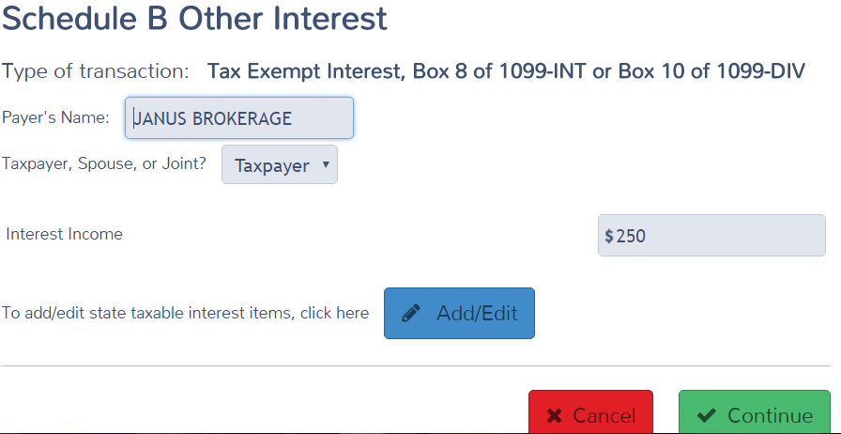
TS - 1099-DIV Exempt Interest Dividends Federal section \ Income \ Enter Myself \ Interest & Dividends (1099-INT, 1099-DIV) \ Tax Exempt Interest Income, Form 1099-INT, Box 8 or Form 1099-DIV, Box 10
Same screen used for tax-exempt
Interest and exempt interest dividends
Exempt interest dividends for Federal
Click if any exempt interest dividends are taxable for NJ
Notes:
28

Slide 29
TS - 1099-DIV Exempt Interest Dividends That Are Taxable for NJ Federal section \ Income \ Enter Myself \ Interest & Dividends (1099-INT, 1099-DIV) \ Tax Exempt Interest Income, Form 1099-INT, Box 8 or Form 1099-DIV, Box 10
Federal exempt interest dividends
taxable for NJ
Notes:
Pull up TS Dividend Stmt screen
Link from Line 9a on 1040 Page 1 (using arrow or F9), which takes you to Schedule B Interest & Ordinary Dividends screen. Then link from Line 5a to Dividend Income screen OR
Go directly to Dividend Income screen by clicking on Dividend Stmt in Forms Tree
Enter Payer name (abbreviate as needed to fit)
Enter amount from 1099-DIV Box 1a in Ordinary dividends column
Enter amount from 1099-DIV Box 1b in Qualified dividends column
Enter T if 1099 belongs to taxpayer, S for spouse, J if joint names
Enter amount from 1099-DIV Box 2a in Capital Gains column. Will flow through to Schedule D, line 13
Enter amount from 1099-DIV Box 2b in 1250 gain column
Enter amount from 1099-DIV Box 4 in Federal Withheld column
Enter exempt interest dividends received from a mutual fund in Exempt interest dividends column (do not include this amount in Ordinary dividends column). This amount flows to the 1040 line 8b (tax exempt interest).
Note that Non-Dividend Distributions are not entered on TS Dividend Statement screen at all. They are a return of your cost basis & are not taxed until all cost is recovered. Reduce your cost by the amount of Non-Dividend Distributions received when you sell the investment
When AMT PAB causes Alternate Minimum Tax, then return it is out of scope
29

Slide 30
Specified Private Activity Bond Interest or Bond Interest Dividends
Private activity bond interest is tax-exempt for regular tax purposes, but is taxable for Alternative Minimum Tax (AMT) purposes
Reported on 1099-INT in Box 9
Private activity bond interest dividends is the portion of tax-exempt interest dividends that may be subject to AMT
Reported on 1099-DIV Box 11
Enter in Federal section \ Other Taxes \ Alternative Minimum Tax (For 6251)
If taxpayer ends up owing AMT, return is Out of Scope
Notes:
30

Slide 31
TS – Private Activity Bond (PAB) Interest or PAB Interest Dividends Federal section \ Other Taxes \ Alternative Minimum Tax (For 6251)
Specified private activity bond interest
or PAB interest dividends
Buyer’s Name, SS #, Address, & Interest Income
Notes:
31

Slide 32
Interest & Dividends Reported on Schedule K-1 (Partner’s Share of Income)
Schedule K-1 is In Scope only if there are just Interest, Dividend, Capital Gains or Royalties
Always check with experienced counselor for all K-1s
Handling of Capital Gains & Royalties are covered in separate modules
Enter K-1 interest and dividends in Federal section \ Income \ Enter Myself \ Other Income \ K-1 Earnings
Choose specific form that includes the K-1 income
Enter on the interest and/or dividend lines
Notes:
32

Slide 33
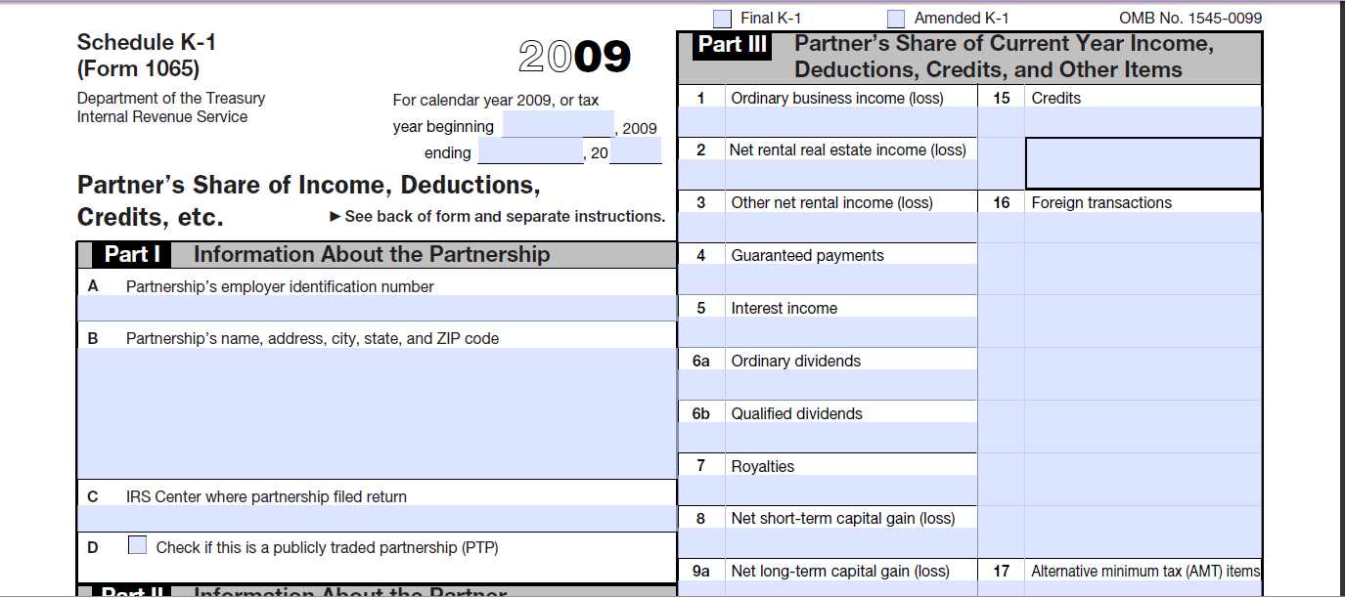
Sample K-1 Interest & Dividends From Schedule K-1
Form #
2015
Interest, Dividends, Capital Gains, Royalties
are only Partnership Income in Scope
Notes:
33

Slide 34
TS - Interest & Dividends From Schedule K-1 Federal section \ Income \ Enter Myself \ Other Income \ K-1 Earnings
Notes:
34

